Slide 1
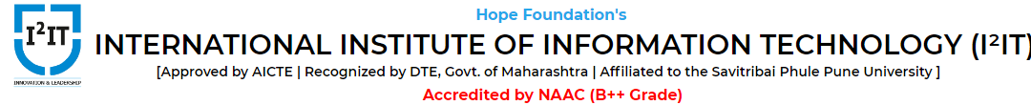
Customer Support Bot
Group Id:- G11
Group Members:-
BC021 - Nikhil Varghese
BC023 - Onkar Sawant
BC027 - Pranav Mene
BC028 - Prathamesh Kurunkar
Project Guide:- Dr. Sandeep Patil

Slide 2
Vibezz
Customer Support Chatbot
Notes:
Final year project

Slide 3
Introduction
A chatbot is an intelligent piece of software that is capable of communicating and performing actions similar to a human. Chatbots are used a lot in customer interaction, marketing on social network sites and for instantly messaging the client.

Slide 4
Project Need
64% of customers expect round the clock service from businesses, and 55% expect instant response to their raised queries. [1]
Giving 24/7 support service is difficult, so businesses have to allocate separate resources for support desks which proves to be costly for most of them.
Businesses generally provide email and call support to their customers. Most people in a tricky situation often use this facility, and remaining individuals however, switch to their competitors if they encounter any issues with their services.
Conversion rates will significantly increase if businesses start relying on customer service bots.
Notes:
Bots possibly are the only solution to respond to customers in no time and all along

Slide 5
Objectives
The customer experience management market worldwide is worth as much as $7.6 billion in 2020. This is a 16.9% year-over-year increase from its value of $6.5 billion in 2019.
Reduce the human interference & manual labour cost.
It will help in providing 24/7 customer service, which will help in the developing better customer satisfaction.
Our customers can get instant answers to their queries.

Slide 6
Requirements
A local machine having Windows / Linux OS with capable processing power.
4 GB RAM or more should be suffice.
1 TB HDD, preferably SSD.
Having a GPU of at least 2 GB will speed up the processing time.

Slide 7
Software / Libraries Used
keras
nltk
pickle
flask

Slide 8
Projects Modules
Intents - The data file which has predefined patterns and responses. Intent refers to the goal the customer has in mind when typing in a question or comment.
Platform UI - The frontend for the businesses
Backend REST API - The server side of the application.

Slide 9
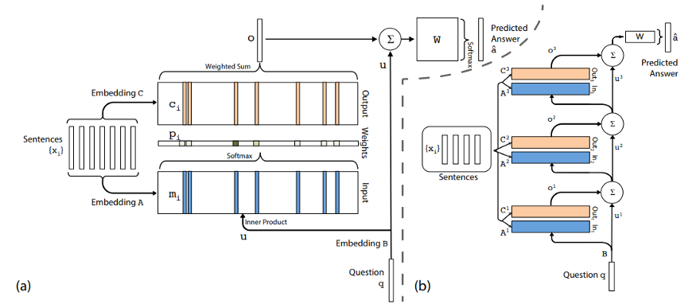
Working

Slide 10
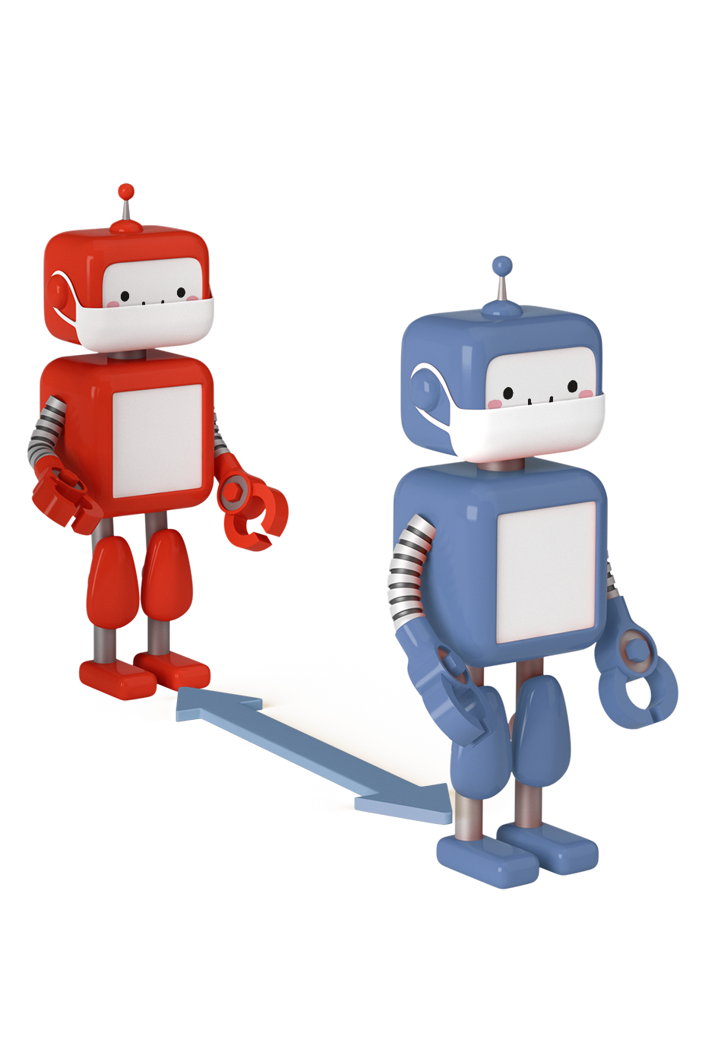
Result
Demonstration Incoming

Slide 11
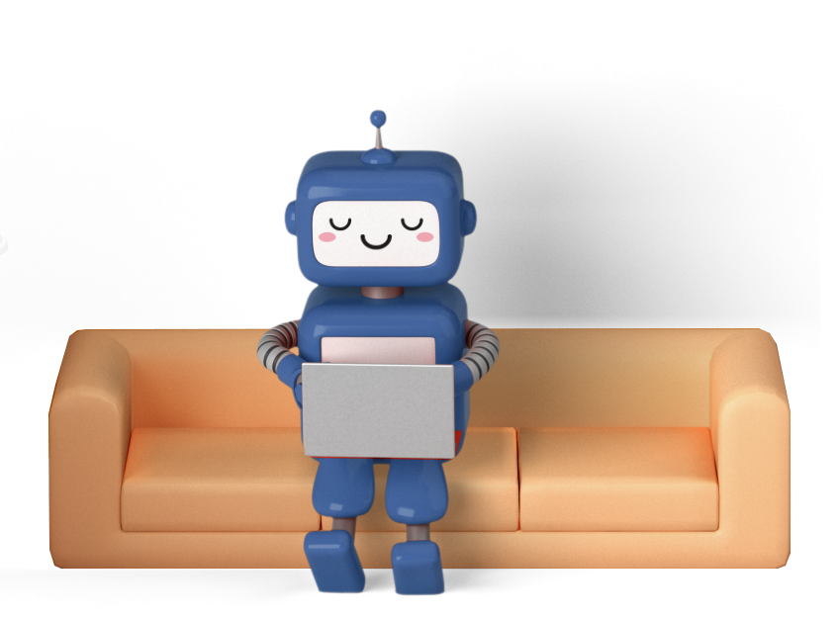
Project Application
Retail and E-Commerce
Travel and Hospitality
Fintech
Healthcare
Education
Media and Entertainment
Business Websites

Slide 12
Future scope
As mentioned at the start of our presentation, we have purposely designed this project in order to scale it up towards our BE project.
Integrate it into BE project to handle business related queries and provide assistance and support to raised queries.
We would like to make our Chatbot more reliable and performant in order to make our application more helpful.
Increase the response quality and improve the analyzing patterns to give more human like responses.

Slide 13
Conclusion
To conclude, we can see that a Chatbot can be made using deep learning and AI technologies, and be used alongside our modern mobile, web and desktop applications to increase overall conversion rates for businesses.

Slide 14
References
https://financesonline.com/chatbot-statistics/#link10
https://towardsdatascience.com/deep-learning-for-nlp-creating-a-chatbot-with-keras-da5ca051e051
https://data-flair.training/blogs/python-chatbot-project/

Slide 15
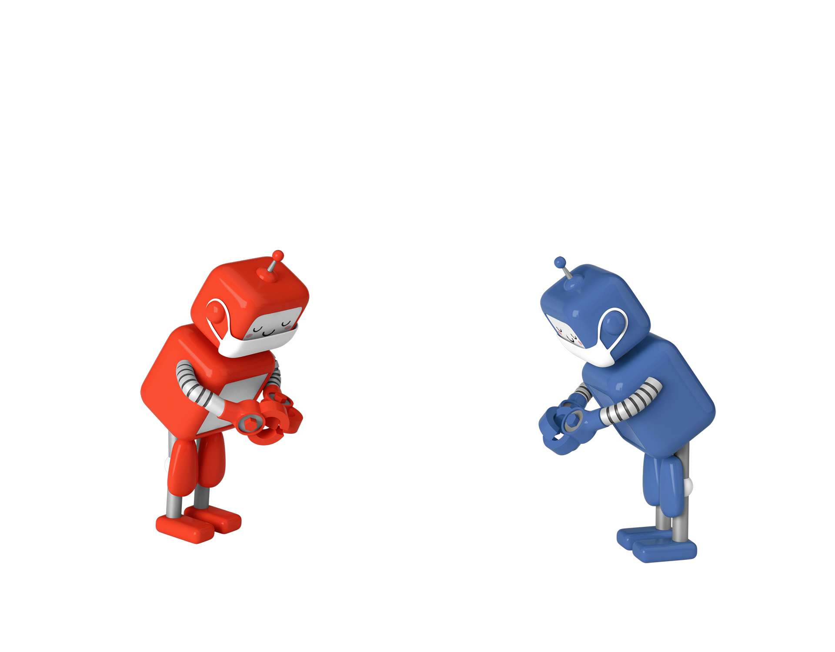
THANK YOU

